Slide 1

CPS3123 - Lecture 4

Slide 2
Topics
Javascript Refresher
Arrays & Prototype Chain
Build-in Modules - Os & Util
Node as a Web Server - Revisited
NPM and NPM Registry
Testing with Mocha

Slide 3
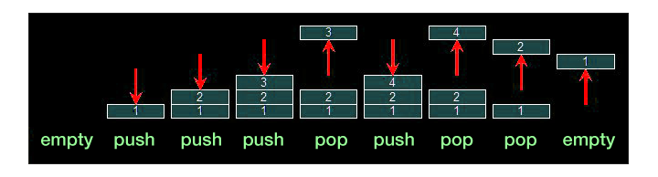
Javascript Arrays
Arrays can be single or multi dimensional
Use push/pop operations to add/remove to the end of the array
Use shift/unshift operations to add/remove to the front of the array.

Slide 4
Javascript Inheritance - Prototype Chain
When it comes to inheritance, Javascript has one construct: objects.
Each object has a private property which holds a link to another object called it’s prototype.
That prototype object has a prototype of its own, and so on until an object is reached with null as its prototype. (final link)
While confusing and often consider one of JavaScript’s biggest weaknesses, it is actually more powerful than the classical model.

Slide 5
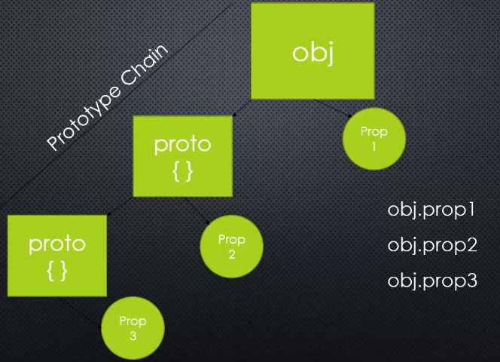
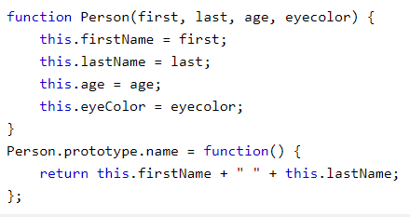
Prototype Chain
* Object.prototype or Object.__prototype to access https://www.w3schools.com/js/js_object_prototypes.asp

Slide 6
The “util” module
https://nodejs.org/docs/latest/api/util.html Provide information utilities about the current running system. It can be accessed by
const util = require(‘util’);
debuglog()
deprecate()
format()
inherits()
inspect()
** inherits() will join the prototype from one object to another

Slide 7
The “os” module
https://nodejs.org/api/os.html Provide information utilities about the current running system. It can be accessed by
const os = require(‘os’);
os.tmpDir()
os.hostname()
os.type()
os.platform()
os.arch()
os.release()
os.uptime()
os.loadavg()
os.totalmem()
os.freemem()
os.cpus()
os.networkInterfaces()
as.EOL

Slide 8
Web Server and HTTP

Slide 9
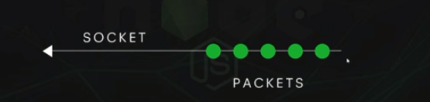
TCP/IP
Stands for Transmission Control Protocol/Internet Protocol
These two protocols were developed in the early days of the internet by U.S Military
IP refers to the moving of data packets between nodes.
It is the foundation of the Internet

Slide 10
HTTP
A set of rules (and format) for data being transferred on the web
It stands for Hypertext Transfer Protocol
It’s a format of defining data being transferred via TCP/IP

Slide 11
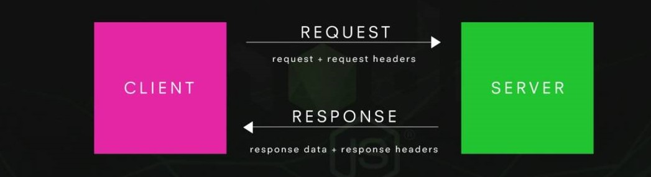
Response Headers

Slide 12
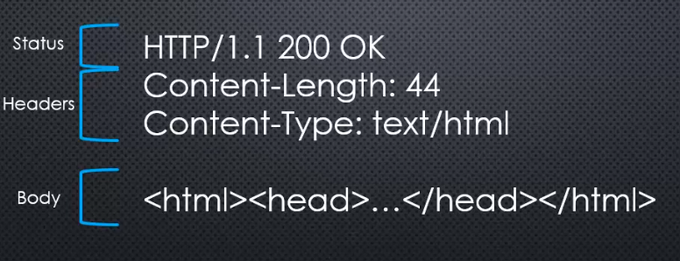
Response Header

Slide 13
API
Stands for Application Programming Interface
It allows one piece of software to interact with another piece of software
This interface is made available on the web via a set of URLs
These URLs only accept and send data via HTTP and TCP/IP

Slide 14
Endpoint
One URL in a Web API
Sometimes that endpoint (URL) does multiple things by making choices based on the HTTP request headers.
Endpoints give and receive data in multiple formats, the most popular being JSON data.

Slide 15
Routing
Mapping HTTP Request to Content
(Whether actual files exist on server or not)

Slide 16
NPM and NPM Registry

Slide 17

NPM
NPM stands for Node Package Manager
It is the default package manager for the JavaScript runtime environment Node.js
It consists of command line client, also called NPM and an online database of public and paid-for private packages, called the NPM registry

Slide 18
Use npm to...
Adapt packages of code to your apps, or incorporate packages as they are.
Download standalone tools you can use right away.
Share code with any npm user, anywhere.
Update applications easily when underlying code needs updating.
Manage multiple version of code and code dependencies.

Slide 19
NPM - CLI (Command Line Interface) common commands
npm install - installs a package
npm uninstall - uninstalls a package
npm init - creates a package.json file
npm test - tests a package
npm ls - lists installed packages
npm help - get help on npm
Full list of commands can be found at https://docs.npmjs.com/cli/

Slide 20
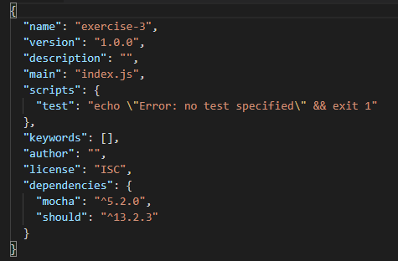
NPM - init
Npm init - will create a package.json file
* version - a version number that should be understandable by node-semver.

Slide 21
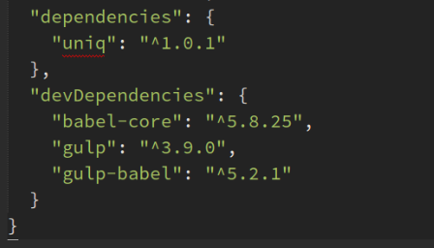
NPM - CLI (Command Line Interface) flags
npm install --global - installs global only to your local machine ie. express
npm install --save - installs as dependency to your package.json file ie.
npm install --save--dev - installs as a dev dependency to your package.json file
This allows anyone who might develop on or use the project to install the dependencies with a simple npm instal command.

Slide 22
NPM - Semver
Semver - stands for Semantic Versioning https://semver.org/
Semantic versioning is a way to specify package versions with a three part version number
Logical comparison operators, and some wildcarding allow you to control which version(s) of a package you want

Slide 23
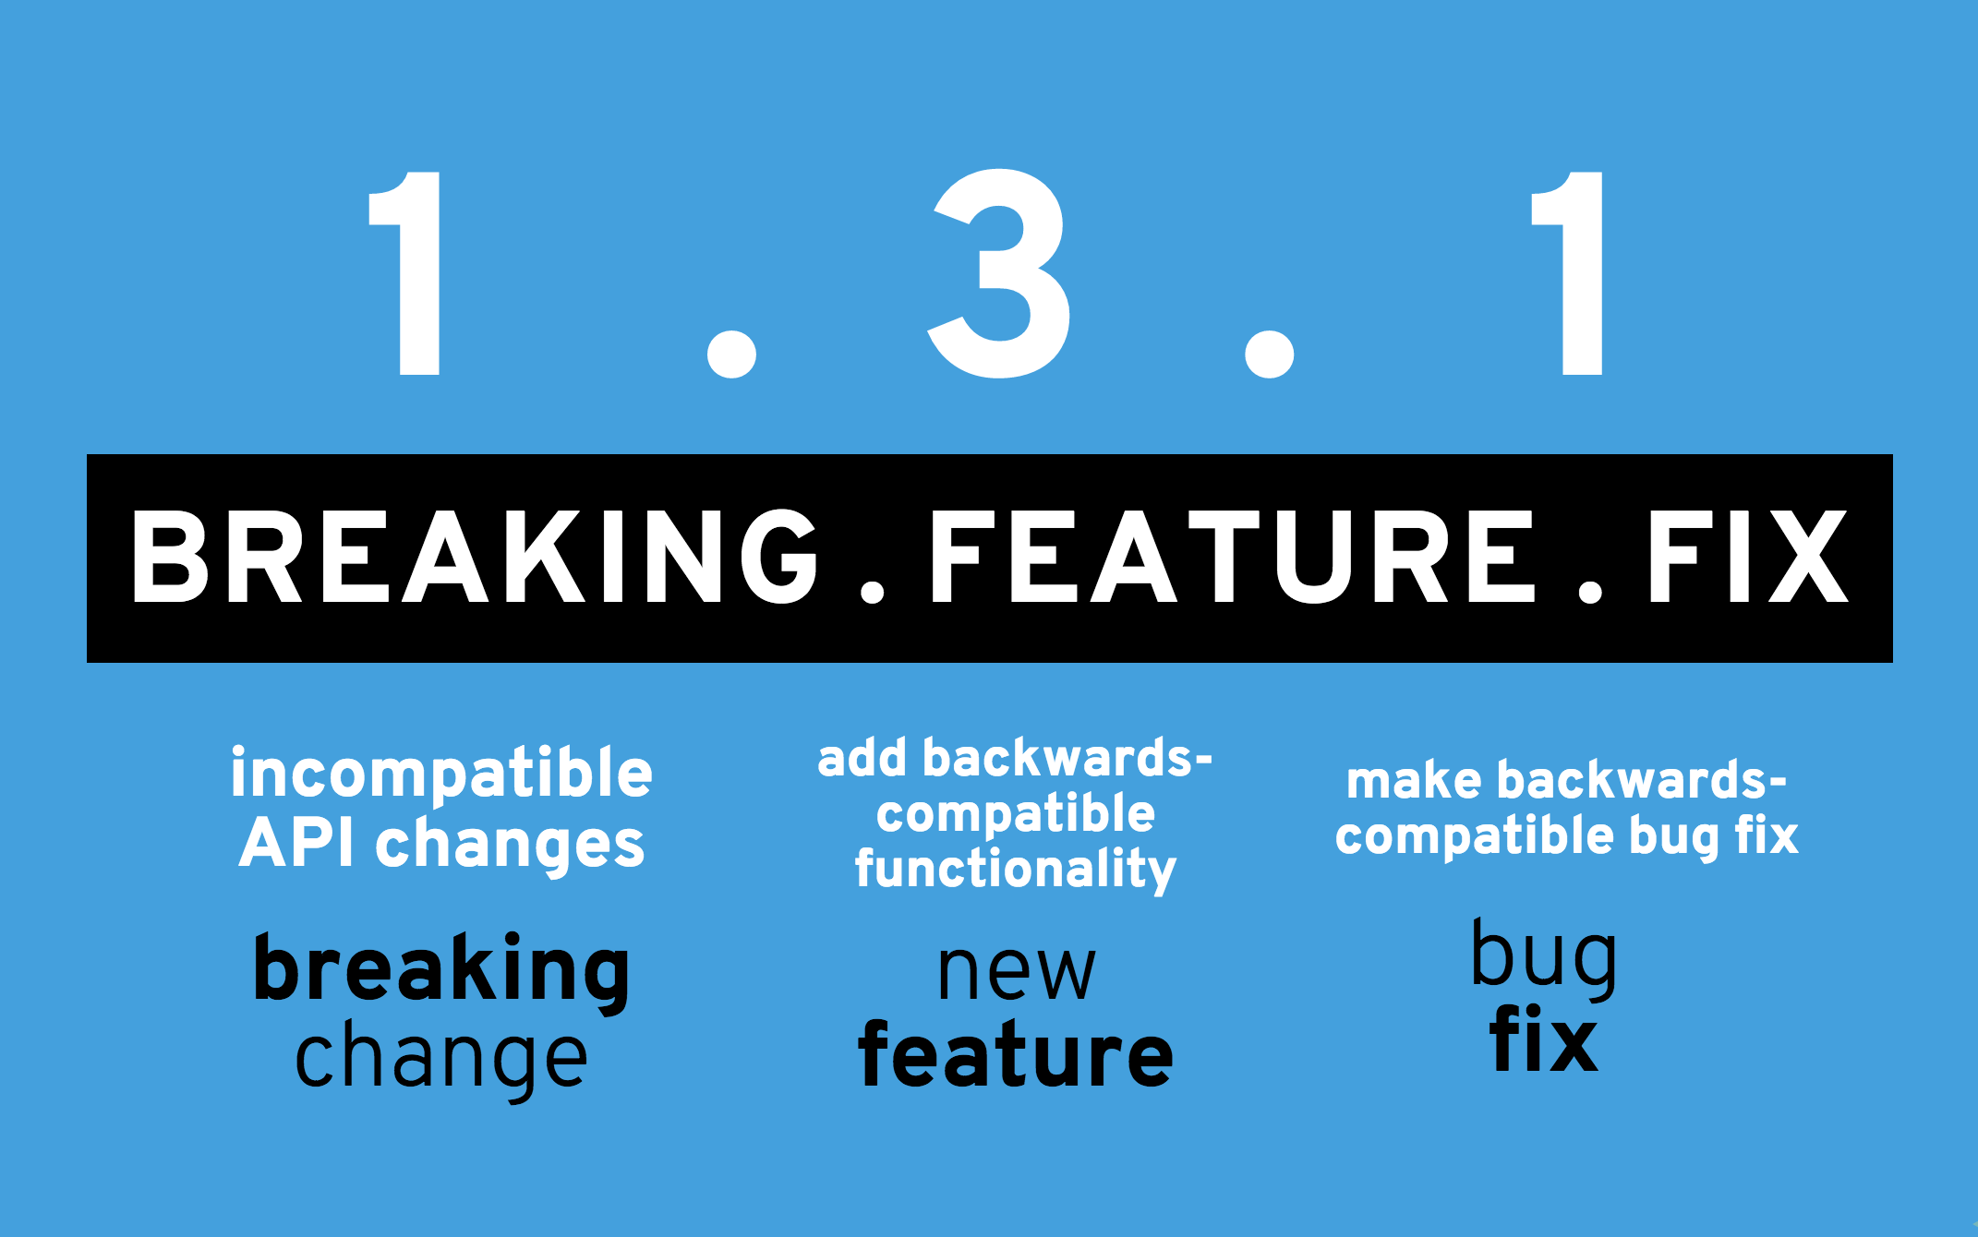
Semantic Versioning

Slide 24
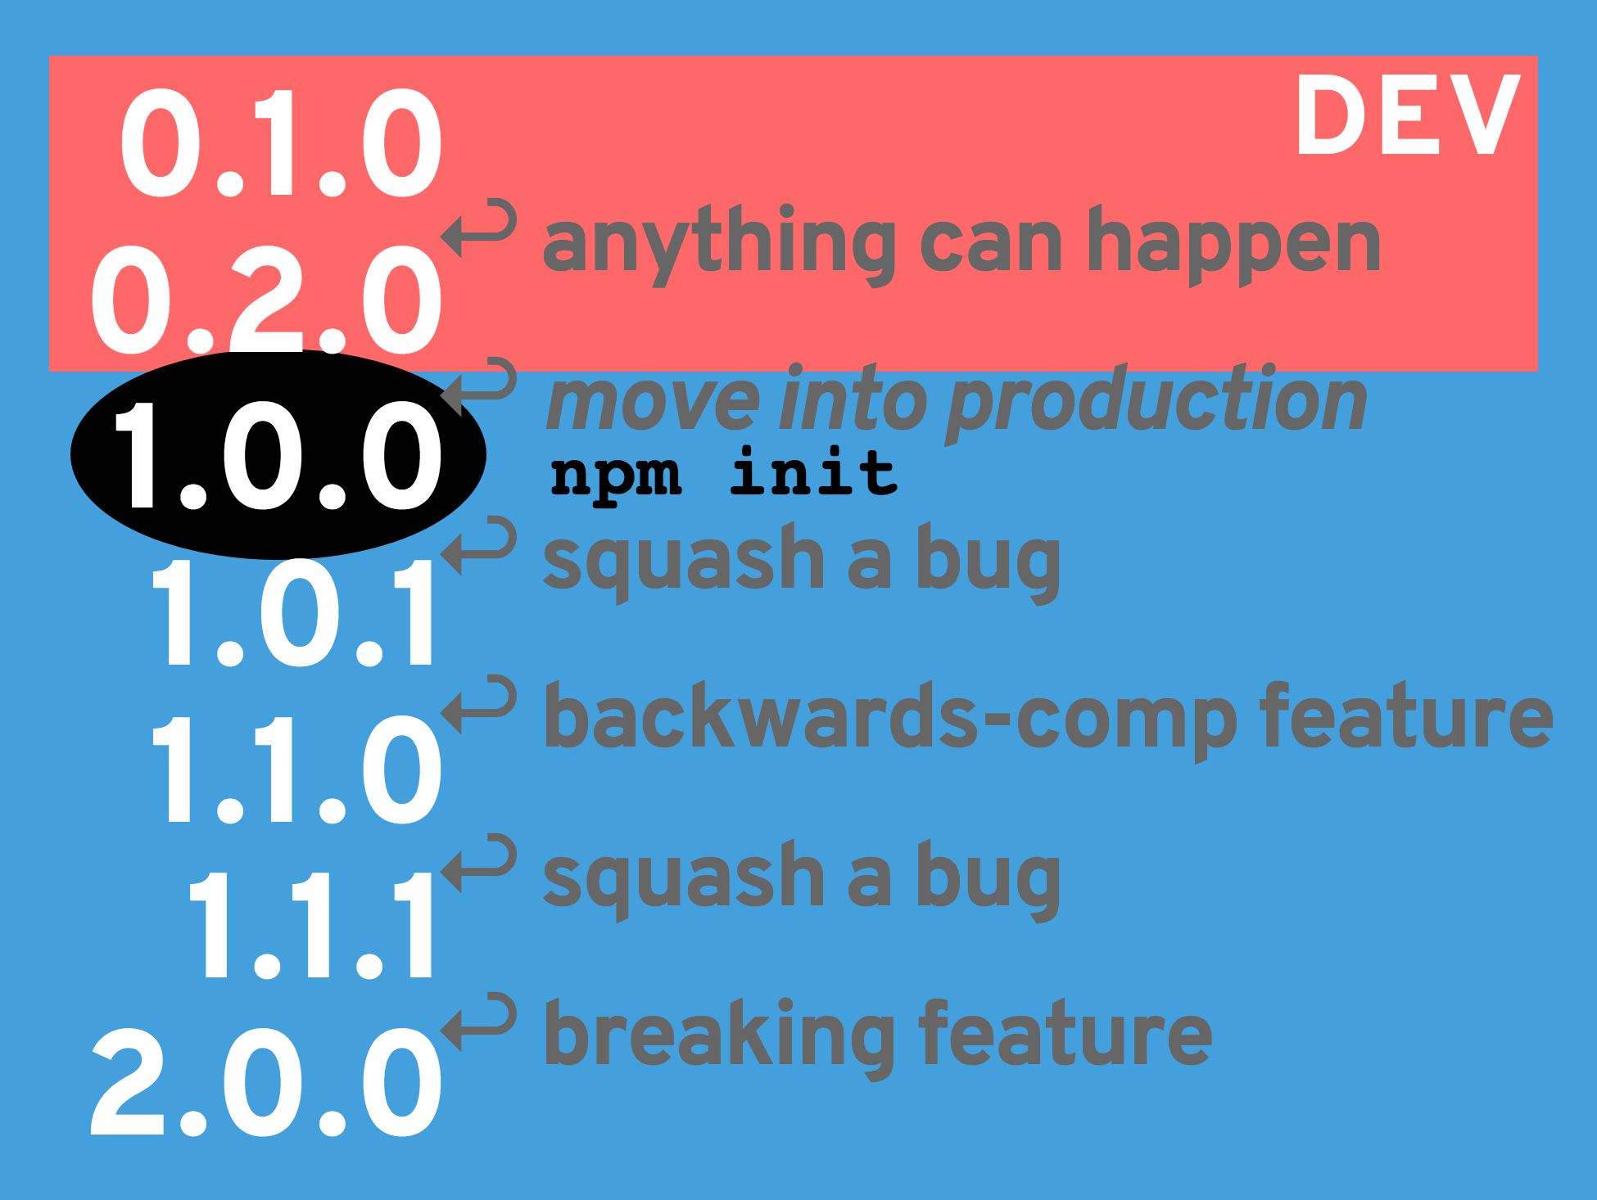
Semantic Versioning

Slide 25
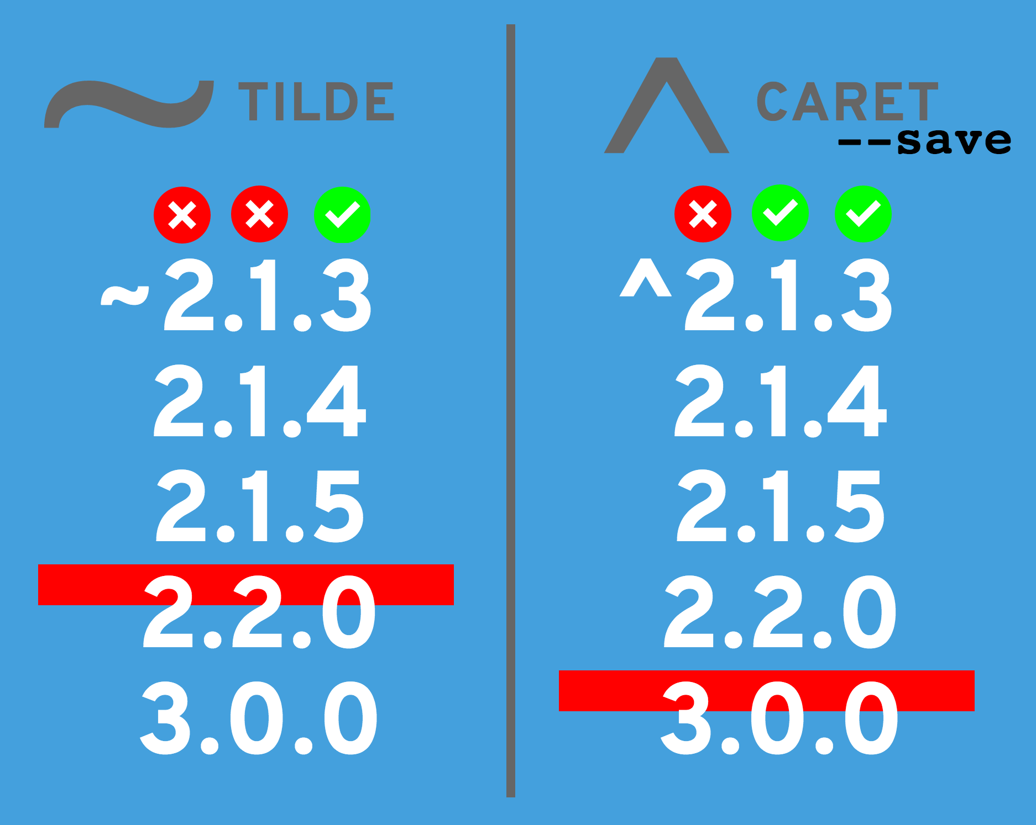
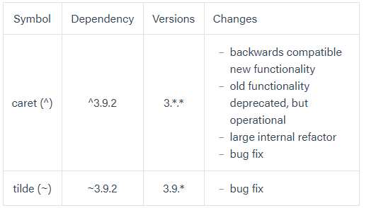
Semver - Range Specifiers

Slide 26
Unit Testing with Mocha

Slide 27
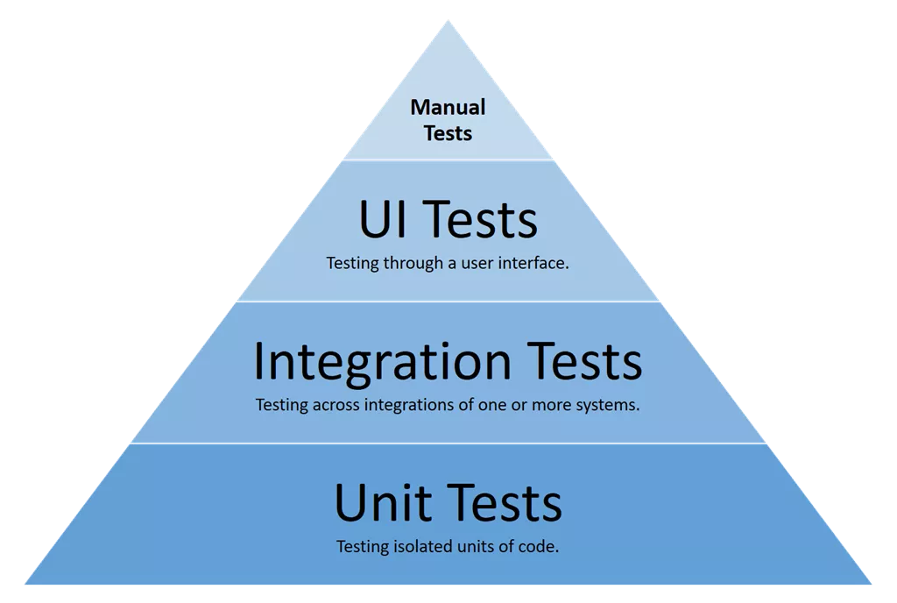
Unit Testing vs Integration Testing
The smallest parts of an application are called units, testing those isolated units is called unit testing.
Integration testing, is the testing between two units

Slide 28

Mocha - Javascript Test Framework
Mocha is a feature-rich Javascript test frameworks running on node and the browser.
Main features:
Provides testing for synchronous and asynchronous code easily
Highly flexible, choose and join the pieces yourself (spy library, assertion library, etc)
Supports both TDD and BDD styles
BDD - describe it, before, after, beforeEach, afterEach
https://mochajs.org/

Slide 29
Assertions with Should.js
Mocha is a feature-rich Javascript test frameworks running on node and the browser.
Main features:
Provides testing for synchronous and asynchronous code easily
Highly flexible, choose and join the pieces yourself (spy library, assertion library, etc)
Supports both TDD and BDD styles
BDD - describe it, before, after, beforeEach, afterEach

Slide 30
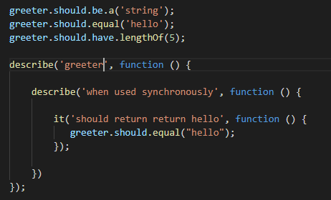
Assertions with Should.js
Should is an expressive, readable assertion library.
The main goals of this library are to be expressive and helpful
The chain-capable BDD styles provide an expressive language and readable style

